Slide 1
Data Governance Policies and Procedures
IS465: Data Management and Governance

Slide 2
Outline
Data Governance Policies
Data Governance Standards
Data Governance Procedures
Data Governance Implementation
Metrics, Reports, and Risks

Slide 3
Data Governance Policies

Slide 4
Data Governance Policies
Data governance policies are the rules, procedures, and guidelines that organizations follow to ensure the effective management of their data assets.
The purpose of data governance policies is to ensure data quality, security, accessibility, and retention.

Slide 5
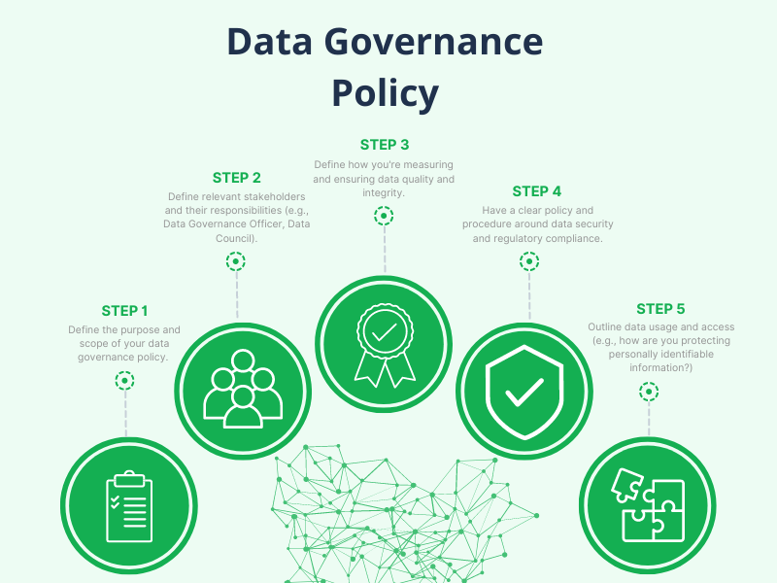

Slide 6
Importance of Data Governance Policies
Data governance policies are essential for ensuring data quality, security, accessibility, and retention.
They help organizations comply with legal and regulatory requirements related to data management.
They promote data sharing and collaboration across different departments and teams.
They help organizations make informed decisions based on accurate and reliable data.

Slide 7
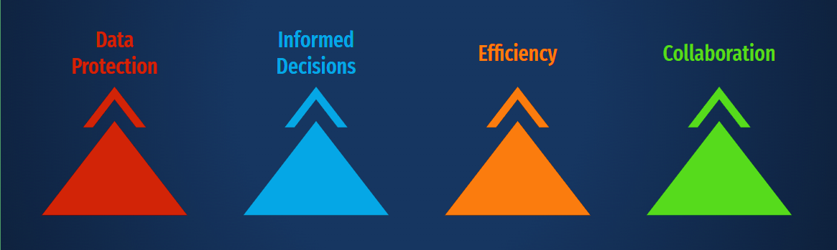
Why Are Data Governance Policies Important?

Slide 8
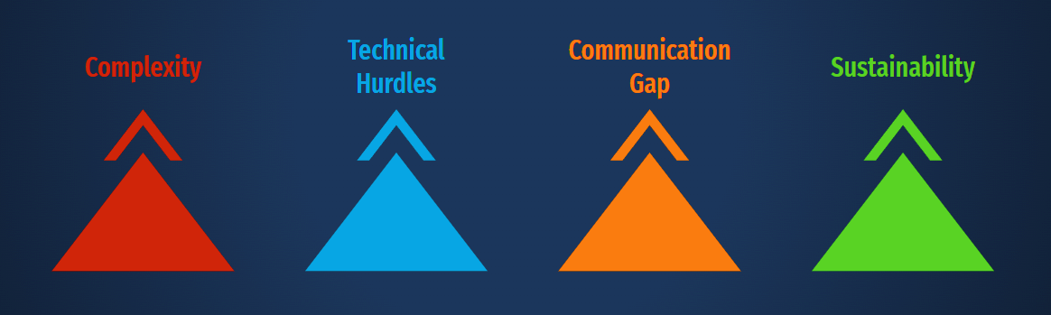
Challenges Organizations Face

Slide 9
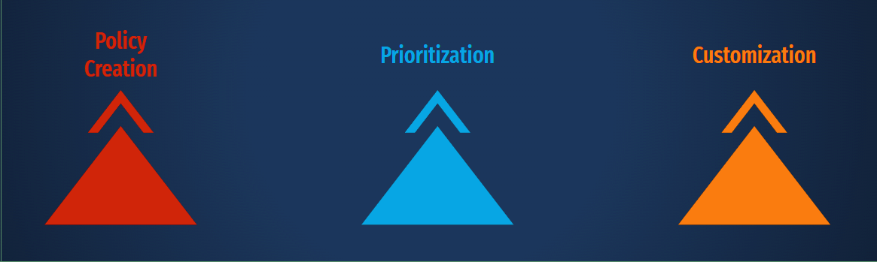
The Policy Framework

Slide 10
Types of Data Governance Policies
Data quality policies
Data security policies
Data access policies
Data retention policies
Data classification policies

Slide 11
Data Quality Policies
Data quality policies aim to ensure that data is accurate, complete, and consistent.
Examples of data quality policies include:
Data validation rules
Data cleansing procedures
Data normalization standards

Slide 12
Data Security Policies
Data security policies aim to protect data from unauthorized access, corruption, or loss.
Examples of data security policies include:
Access controls
Encryption protocols
Authentication procedures

Slide 13
Data Access Policies
Data access policies aim to ensure that data is accessible to authorized users and groups.
Examples of data access policies include:
User authentication procedures
Authorization protocols
Role-based access controls

Slide 14
Data Retention Policies
Data retention policies aim to ensure that data is properly stored and retained according to organizational policies and legal requirements.
Examples of data retention policies include:
Data backup procedures
Data archiving protocols
Retention schedules

Slide 15
Data Governance Standards

Slide 16
Data Governance Standards
Data governance standards are guidelines and frameworks that organizations follow to ensure the effective management of their data assets.
The purpose of data governance standards is to provide a consistent and repeatable approach to data management, ensuring data quality, security, accessibility, and retention.

Slide 17
Importance of Data Governance Standards
Data governance standards are essential for ensuring data quality, security, accessibility, and retention.
They help organizations comply with legal and regulatory requirements related to data management.
They promote data sharing and collaboration across different departments and teams.
They help organizations make informed decisions based on accurate and reliable data.

Slide 18
Types of Data Governance Standards
Industry-specific standards
These standards are developed for specific industries, such as healthcare, finance, and retail.
Generic standards
These standards can be applied to any industry and are developed by organizations such as ISO and ITU.
Framework standards
These standards provide a structured approach to data governance, such as the Data Governance Body of Knowledge (DGBOK) and the Information Governance Initiative (IGI).

Slide 19
Industry-Specific Data Governance Standards
Examples of industry-specific data governance standards include:
HIPAA (Health Insurance Portability and Accountability Act) for healthcare
GDPR (General Data Protection Regulation) for EU data protection
PCI-DSS (Payment Card Industry Data Security Standard) for payment card data
FISMA (Federal Information Security Management Act) for US federal government data

Slide 20
Generic Data Governance Standards
Examples of generic data governance standards include:
ISO/IEC 27001:2022
Information security, cybersecurity and privacy protection - Information security management systems
ITU-T
(International Telecommunication Union - Telecommunication standardization sector) recommendations
COBIT
(Control Objectives for Information and Related Technology) framework

Slide 21
Framework Data Governance Standards
Examples of framework data governance standards include:
Data Governance Body of Knowledge (DGBOK)
Information Governance Initiative (IGI)
Data Governance Framework (DGF)

Slide 22
Benefits of Implementing Data Governance Standards
Implementing data governance standards can help organizations:
Ensure data quality, security, accessibility, and retention
Comply with legal and regulatory requirements
Promote data sharing and collaboration
Make informed decisions based on accurate and reliable data
Reduce data-related risks and costs

Slide 23
Data Governance Procedures

Slide 24
Data Governance Procedures
Data governance procedures are the specific steps and processes that organizations follow to ensure the effective management of their data assets.
The purpose of data governance procedures is to provide a structured approach to data management, ensuring data quality, security, accessibility, and retention.

Slide 25
Importance of Data Governance Procedures
Data governance procedures are essential for ensuring data quality, security, accessibility, and retention.
They help organizations comply with legal and regulatory requirements related to data management.
They promote data sharing and collaboration across different departments and teams.
They help organizations make informed decisions based on accurate and reliable data.

Slide 26
Types of Data Governance Procedures
Data management procedures
Data security procedures
Data quality procedures
Data retention procedures

Slide 27
Data Management Procedures
Examples of data management procedures include:
Data creation: Ensuring that new data is created and captured accurately and completely.
Data modification: Ensuring that data is updated and modified accurately and completely.
Data deletion: Ensuring that data is deleted appropriately and securely.
Data archiving: Ensuring that data is transferred to long-term storage appropriately and securely.

Slide 28
Data Security Procedures
Examples of data security procedures include:
Encryption: Protecting data from unauthorized access by using encryption techniques.
Access controls: Restricting access to data based on user roles and permissions.
Authentication: Verifying the identity of users before granting access to data.
Authorization: Granting access to data based on user roles and permissions.

Slide 29
Data Quality Procedures
Examples of data quality procedures include:
Data validation: Checking data for accuracy and completeness.
Data cleansing: Identifying and correcting errors or inconsistencies in data.
Data normalization: Transforming data into a consistent format.

Slide 30
Data Retention Procedures
Examples of data retention procedures include:
Data backups: Creating copies of data to protect against data loss.
Data archiving: Transferring data to long-term storage.
Data disposal: Disposing of data securely and appropriately.

Slide 31
Data Governance Implementation

Slide 32
Key Data Governance Best Practices
Define data governance roles and responsibilities.
Establish data management policies and procedures.
Implement data security measures.
Monitor and audit data access and use.
Provide training and awareness programs.
Regularly review and update data governance policies and procedures.

Slide 33
Importance of Data Governance Implementation
Data governance implementation is essential for ensuring data quality, security, accessibility, and retention.
It helps organizations comply with legal and regulatory requirements related to data management.
It promotes data sharing and collaboration across different departments and teams.
It helps organizations make informed decisions based on accurate and reliable data.

Slide 34
Key Steps in Data Governance Implementation
Step 1: Define data governance roles and responsibilities.
Step 2: Establish data management policies and procedures.
Step 3: Implement data security measures.
Step 4: Monitor and audit data access and use.
Step 5: Provide training and awareness programs.
Step 6: Regularly review and update data governance policies and procedures.

Slide 35
Metrics, Reports, and Risks

Slide 36
Importance of Data Governance Metrics
Data governance metrics are essential for evaluating the effectiveness of data governance practices.
They help organizations identify areas for improvement and measure progress over time.
They provide a common language and framework for communication about data governance across different departments and teams.

Slide 37
Key Data Governance Metrics
Metric 1: Data Quality Index (DQI) - measures the accuracy, completeness, and consistency of data.
Metric 2: Data Security Index (DSI) - measures the effectiveness of data security measures.
Metric 3: Data Accessibility Index (DAI) - measures the ease of access to data for authorized users.
Metric 4: Data Retention Index (DRI) - measures the effectiveness of data retention policies and procedures.
Metric 5: Data Governance Maturity Index (DGMI) - measures the overall maturity of data governance practices.

Slide 38
Data Quality Index (DQI)
The Data Quality Index (DQI) measures the accuracy, completeness, and consistency of data.
Calculation: DQI = (Accuracy + Completeness + Consistency) / 3
Example: A DQI score of 0.8 indicates that data is 80% accurate, complete, and consistent.

Slide 39
Data Security Index (DSI)
The Data Security Index (DSI) measures the effectiveness of data security measures.
Calculation: DSI = (Data Encryption + Access Controls + Incident Response) / 3
Example: A DSI score of 0.9 indicates that data security measures are 90% effective.

Slide 40
Importance of Data Governance Monitoring and Reporting
Data governance monitoring and reporting are essential for ensuring data quality, security, accessibility, and retention.
They help organizations comply with legal and regulatory requirements related to data management.
They promote data sharing and collaboration across different departments and teams.
They help organizations make informed decisions based on accurate and reliable data.

Slide 41
Key Data Governance Monitoring and Reporting Tools
Tool 1: Data Governance Dashboards - provide real-time visibility into data quality, security, accessibility, and retention.
Tool 2: Data Quality Reports - measure data accuracy, completeness, and consistency.
Tool 3: Data Security Reports - measure data security controls and incident response.
Tool 4: Data Accessibility Reports - measure data availability and usability.
Tool 5: Data Retention Reports - measure data retention and disposal practices.

Slide 42
Data Governance Dashboards
Data governance dashboards are interactive tools that provide real-time visibility into data quality, security, accessibility, and retention.
Features:
Data quality metrics (e.g., accuracy, completeness, consistency)
Data security metrics (e.g., encryption, access controls, incident response)
Data accessibility metrics (e.g., data availability, usability)
Data retention metrics (e.g., data retention schedules, disposal practices)
Benefits:
Real-time visibility into data governance practices
Easy-to-understand metrics and reports
Identification of areas for improvement

Slide 43
Data Quality Reports
Data quality reports measure data accuracy, completeness, and consistency.
Metrics:
Data accuracy (e.g., percentage of accurate data)
Data completeness (e.g., percentage of complete data)
Data consistency (e.g., percentage of consistent data)
Benefits:
Identification of data quality issues
Tracking of data quality over time
Improvement of data quality practices

Slide 44
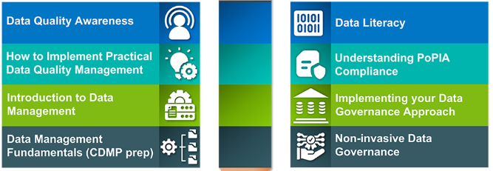
Importance of Data Governance Training and Awareness
Data governance training and awareness are essential for ensuring effective data management practices.
They help employees understand data governance policies, procedures, and best practices.
They promote major data governance goals such as data quality, security, accessibility, and retention.

Slide 45
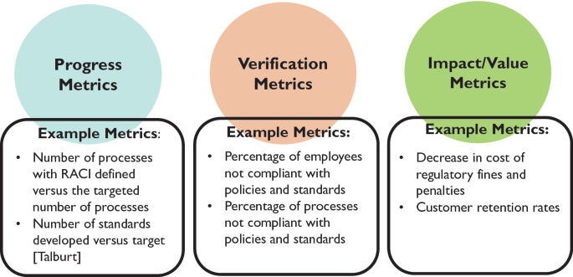
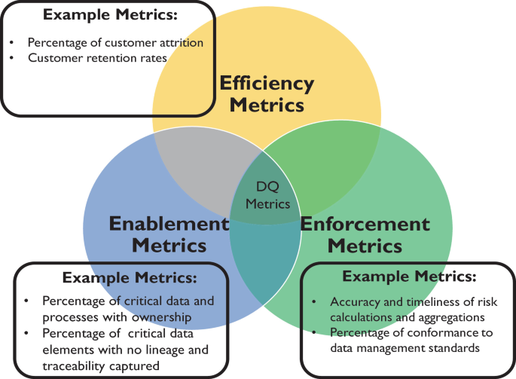
Data Governance Metrics and Performance Indicators
Metrics and performance indicators are used to measure the effectiveness of data governance practices.

Slide 46
Data Governance Risk Management
Data governance risk management involves identifying, assessing, and mitigating risks associated with data management.
The purpose of data governance risk management is to ensure that data is accurate, complete, and protected from unauthorized access or misuse.

Slide 47
Importance of Data Governance Risk Management
Data governance risk management is essential for ensuring the integrity and security of data.
It helps organizations comply with legal and regulatory requirements related to data management.
It promotes data sharing and collaboration across different departments and teams.
It helps organizations make informed decisions based on accurate and reliable data.

Slide 48
Key Data Governance Risk Management Strategies
Strategy 1: Data Classification
Strategy 2: Access Control
Strategy 3: Data Encryption
Strategy 4: Data Backup and Recovery
Strategy 5: Data Quality Control

Slide 49
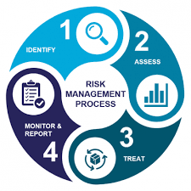
Data Governance Risk Management Framework
Framework:
Identify risks
Assess risks
Mitigate risks
Monitor risks
Risk management process:
Risk identification
Risk assessment
Risk mitigation
Risk monitoring

Slide 50
Data Governance Risk Identification
Identifying risks involves analyzing data management practices and identifying potential risks.
Risks can include data breaches, data corruption, data loss, and non-compliance with regulations.
Techniques for identifying risks include risk assessments, security audits, and compliance audits.

Slide 51
Data Governance Risk Assessment
Risk assessment involves evaluating the likelihood and impact of identified risks.
The likelihood of a risk occurring is determined by analyzing factors such as the probability of a security breach or data corruption.
The impact of a risk occurring is determined by analyzing factors such as the potential financial loss or reputational damage.
Risk assessment tools include risk matrices and risk heat maps.

Slide 52
Data Governance Risk Mitigation
Risk mitigation involves implementing measures to reduce the likelihood or impact of identified risks.
Measures can include implementing security controls, enforcing data access controls, and creating data backup and recovery plans.
Risk mitigation strategies should be tailored to the specific risk and the organization's needs.

Slide 53
Data Governance Risk Monitoring
Risk monitoring involves regularly reviewing and updating risk assessments and risk mitigation measures.
Monitoring helps ensure that risk mitigation measures are effective and that new risks are identified and addressed.
Risk monitoring tools include risk management software and dashboards.

Slide 54
Key Data Governance Future Trends
Trend 1: Artificial Intelligence and Machine Learning
Trend 2: Cloud Computing
Trend 3: Blockchain
Trend 4: Internet of Things (IoT)
Trend 5: Data Privacy and Ethics

Slide 55
Preparing for Data Governance Future Trends
Organizations should stay informed and proactive in adopting new technologies and practices.
Develop a data governance strategy that accommodates emerging trends.
Invest in employee training and upskilling to address future data management challenges.
Foster a culture of data-driven decision-making and ethical data management.

Slide 56
Summary of Key Takeaways
Data governance is a critical aspect of data management.
Data governance roles and responsibilities are essential for ensuring data quality, security, accessibility, and retention.
Data governance roles include data owners, data custodians, data users, and data stewards.
Data governance responsibilities include data management, data security, data quality, data accessibility, and data retention.
Effective data governance requires clear roles and responsibilities, data governance policies and procedures, and regular monitoring and reporting.

Slide 57
Final Thoughts and Call to Action
Data governance is a continuous process that requires ongoing efforts and commitment.
Implementing data governance can seem daunting, but it's essential for ensuring data integrity, security, and compliance.
Start by identifying your organization's data governance needs and developing a data governance strategy.
Assign clear roles and responsibilities, develop policies and procedures, and establish regular monitoring and reporting processes.
Don't wait – start implementing data governance today to ensure your organization's data is accurate, secure, and compliant.

